Slide 1


Trackin!T
Management System
This program is for development teams, customer service departments, delivery notification systems, or Field Fore Automation companies to create tickets and as they close those items they can mark them open, closed, under development and gives a workflow that allows the development manager to see the process for the overall project
Project designed by
Notes:
Ideas:
Trapper Keeper App

Slide 2
A STEP-by-STEP Build of this project
1. Design Home Page
2. Create Database in SQL
3. Connecting Database
4. Design Form for Users Module
5. Create Business Logic Layer – BLL
6. Create Methods to Users
7. Adding ADD, UPDATE, DELETE for Users
8. Upload Images
9. Add Search Functionality for Users
10. Design Form for Customer Module
11. Create BLL for Customer Module
12. Create Methods to Customers
13. Create ADD, UPDATE, DELETE for Customers
14. Upload Profile Picture for Customers
15. Refresh Dashboard on Database Change
16. Add Search Functionality for Customers
17. Design Login Form
18. Add Login Functionality
19. Saving and Displaying Logged in Users
20. Create Animated – Loading Progress – Splash Screen
21. Delete Image File
22. Bug Fixing – Upload Right Way
23. Bug Fixing – Update Image

Slide 3
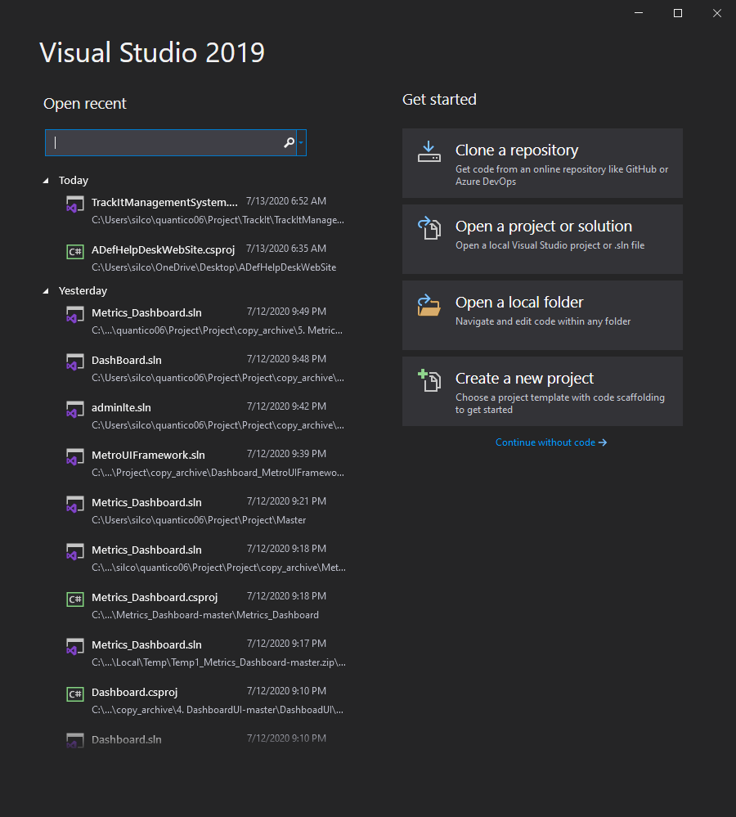
Start Visual Studio
Open Visual Studio
Click on the create a new project

Slide 4
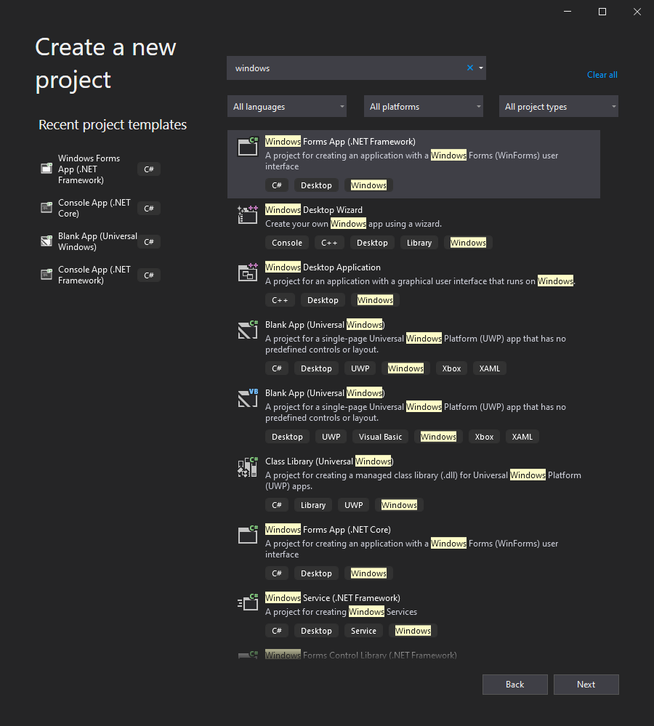
Select Template
Choose a template
Click on the Windows Forms App (.NET Framework) for C#
If you don’t see it, you can type it in the search block on the top
Click Next

Slide 5
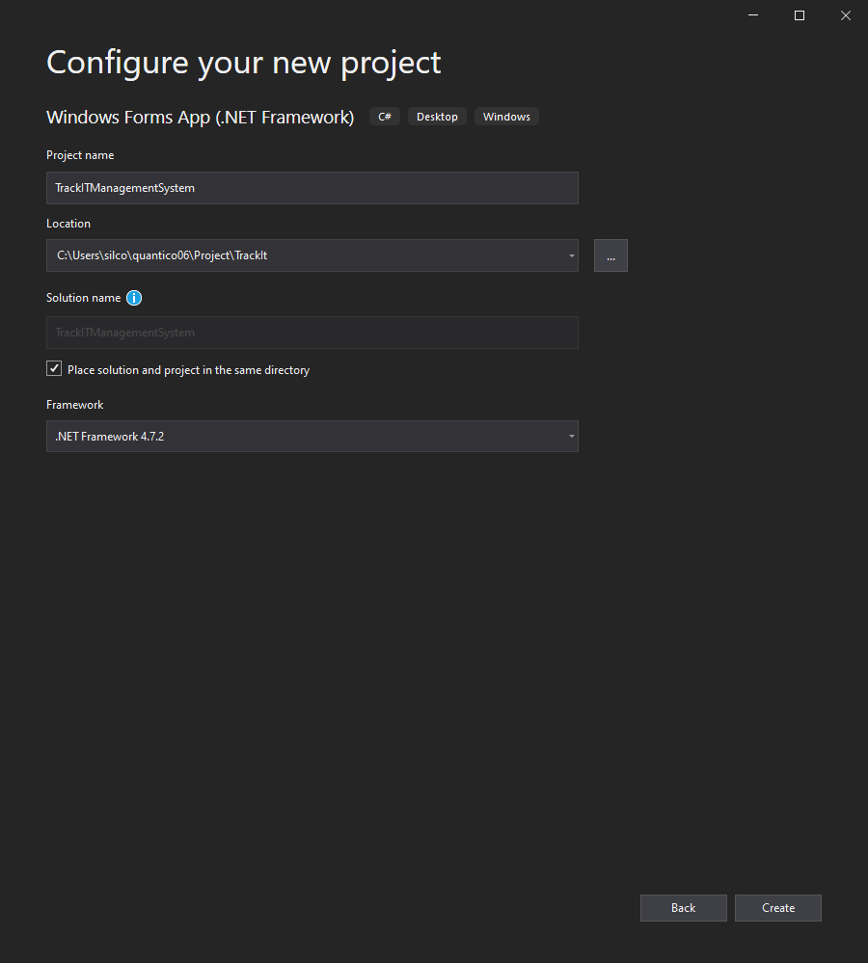
Configure
Configure your new project
Choose a project name, use Pascal name convention
Choose save destination
Have check for solution in the same directory
Create

Slide 6
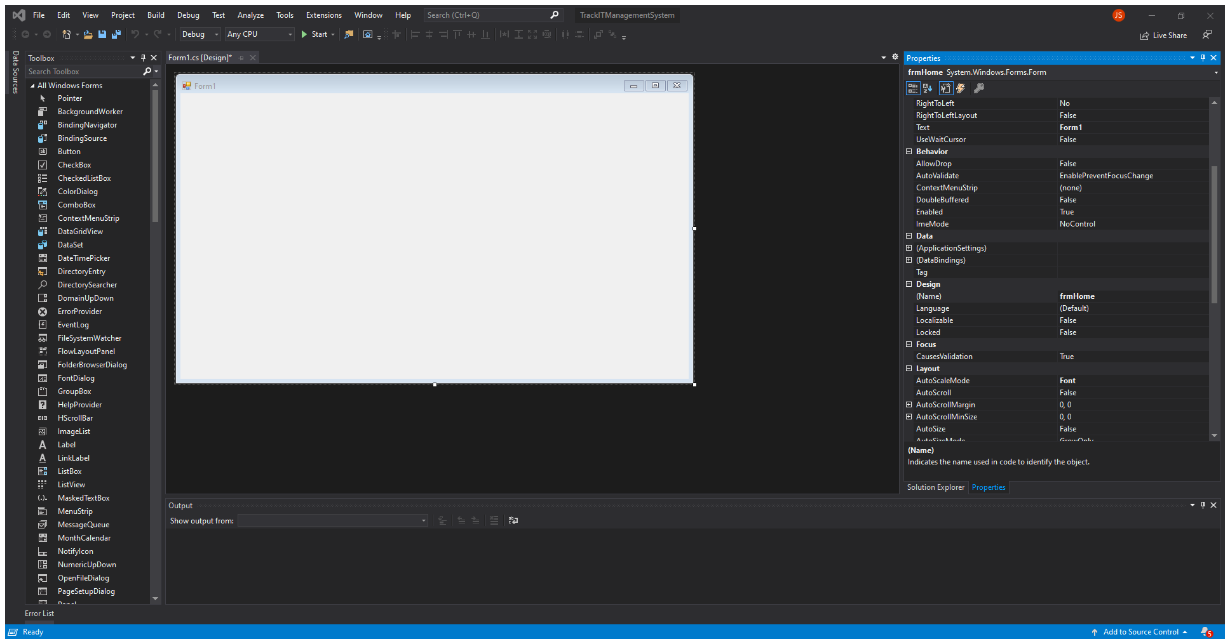
Rename Window
Rename the design
Find the design name and rename it using camel case convention

Slide 7
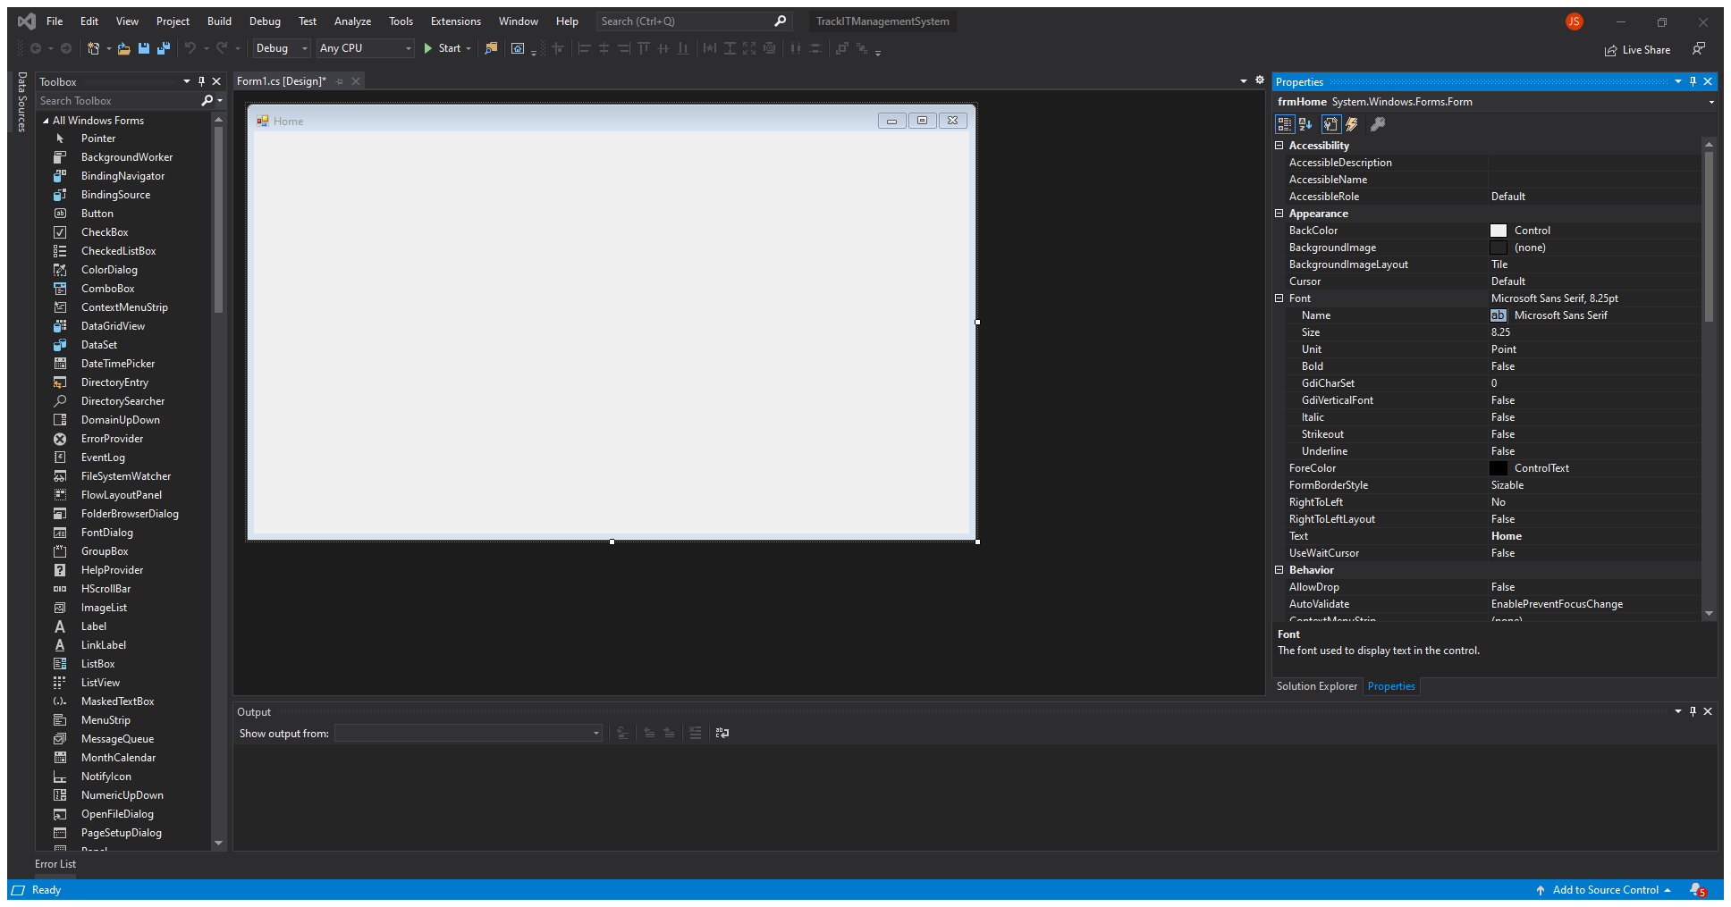
Rename Text
Rename the text
Find the text and rename it using Pascal case convention

Slide 8
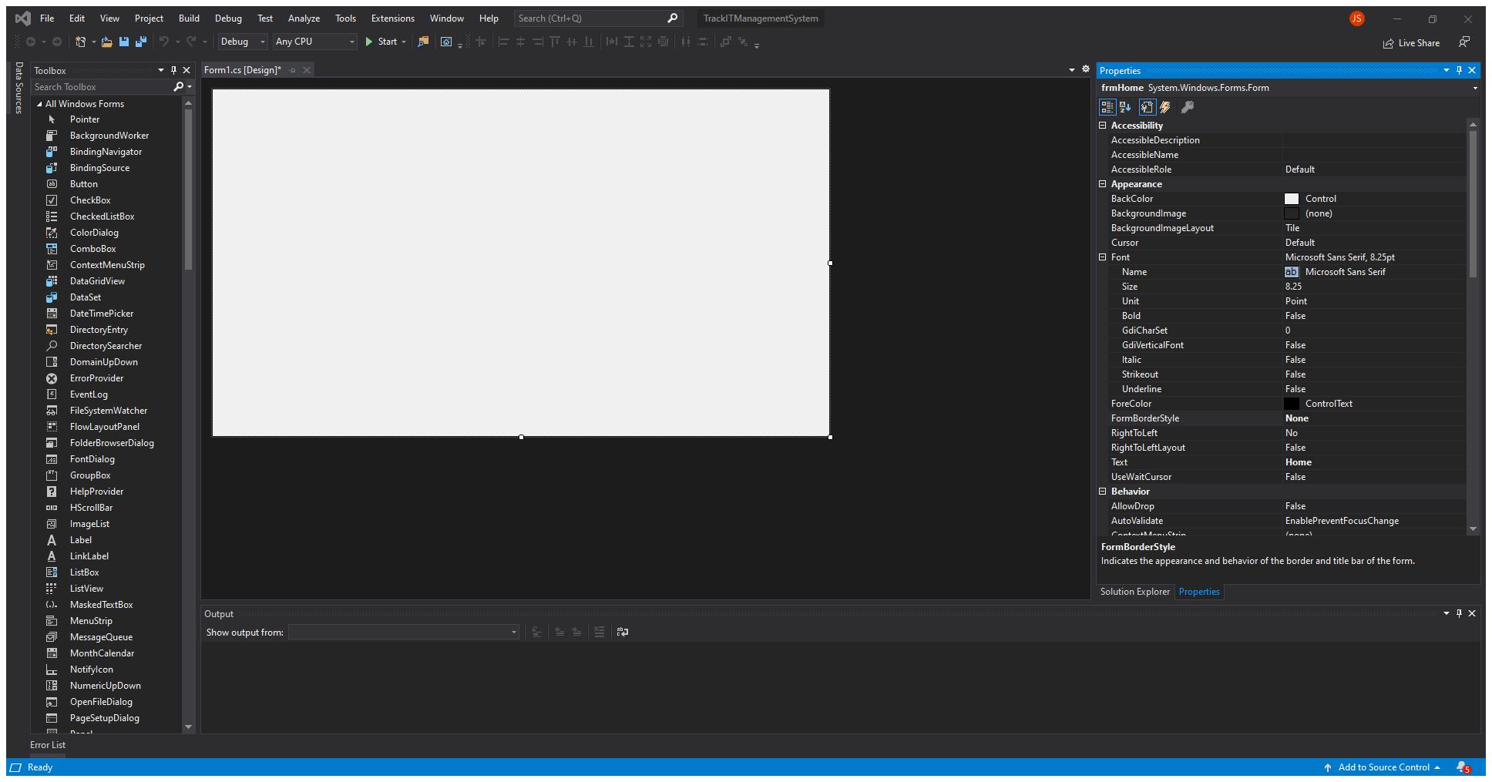
Change Border
Change Border Style
Change to None

Slide 9
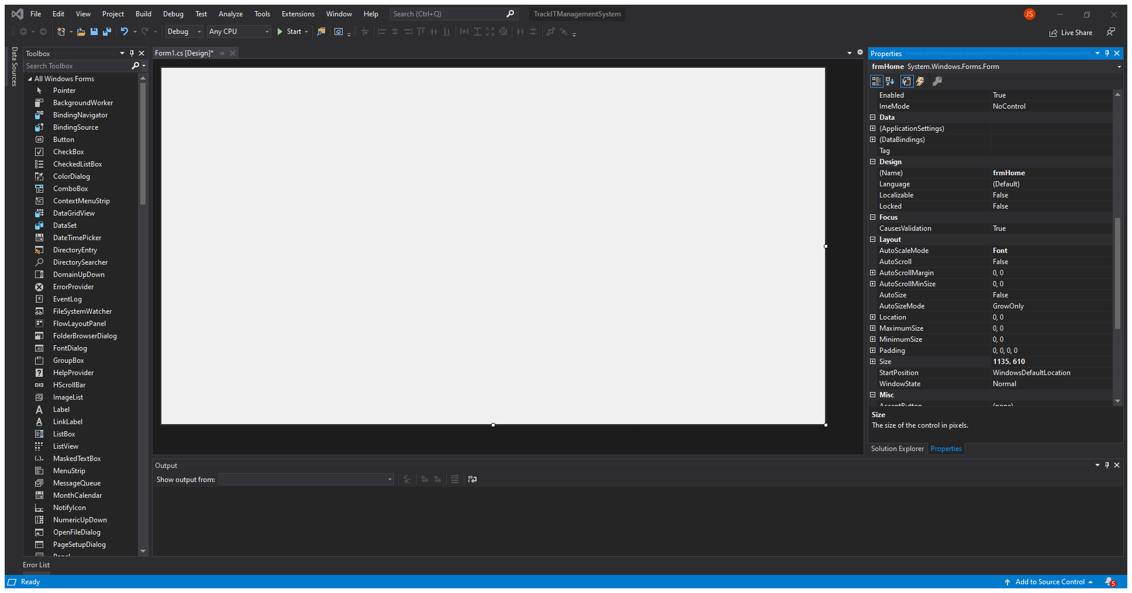
Change Size
Change Window Size
Change to 1135, 610
This is in pixels

Slide 10
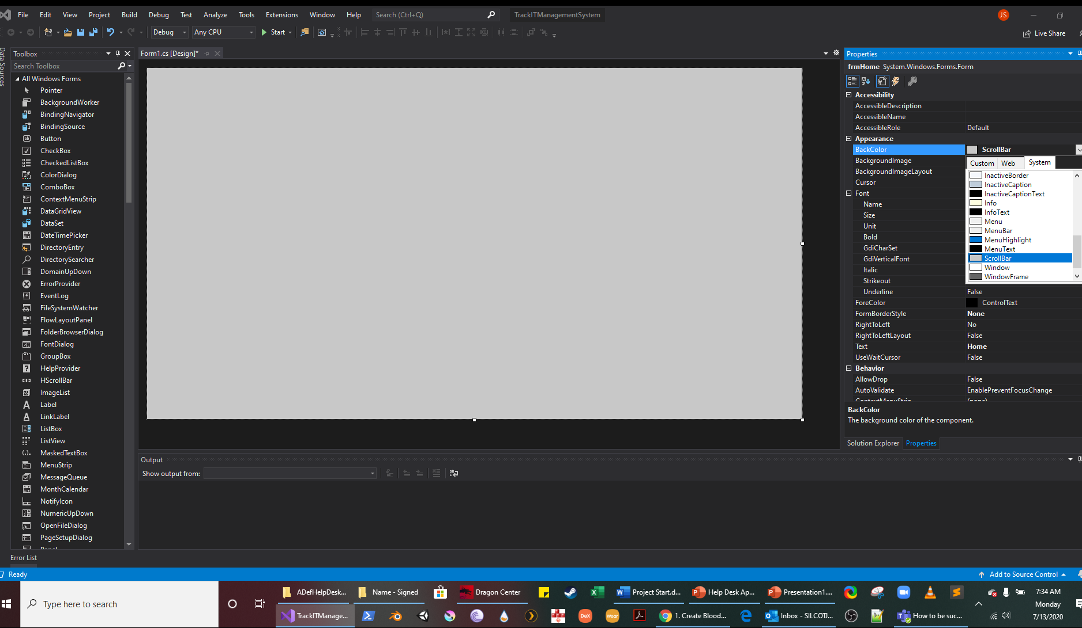
Change Back Color
Change Window BackColor
Use drop down and select ScrollBar

Slide 11
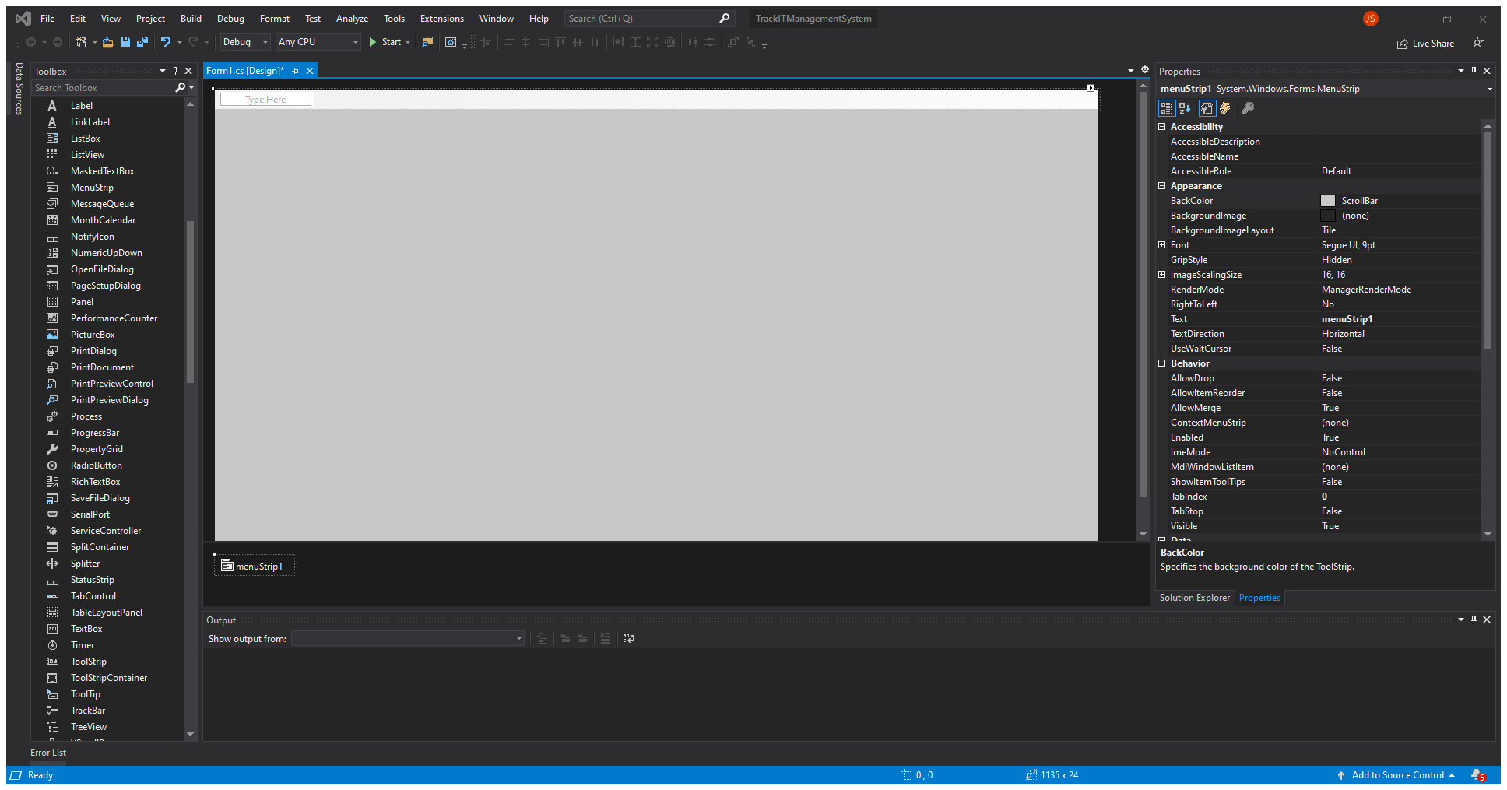
Add Menu Strip
Add Menu Strip
Select the MenuStrip from the Toolbox and drag it to the top of left of the window

Slide 12

Add Menu Names
Type in the new text box
Users
Then add another
Called Admin

Slide 13
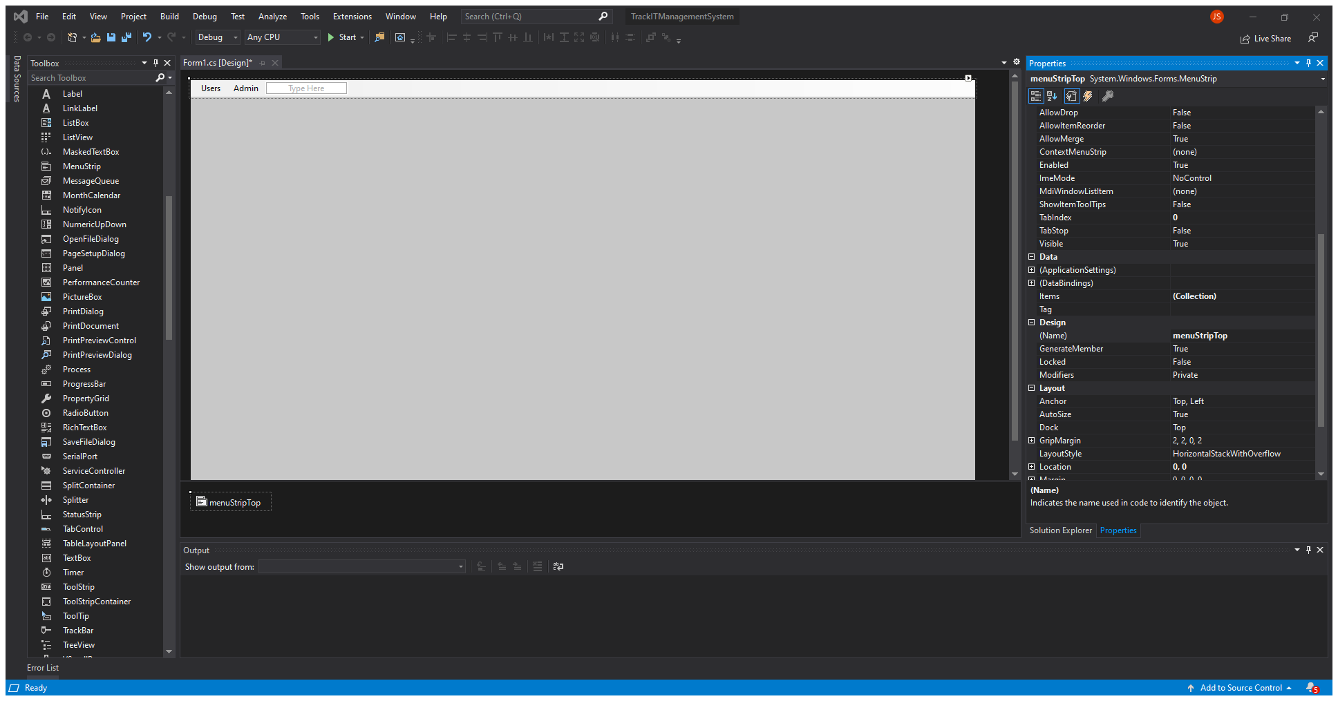
Rename Menu Strip
Rename the Menu Strip in Properties
Rename using camel case
Call it
menuStripTop

Slide 14

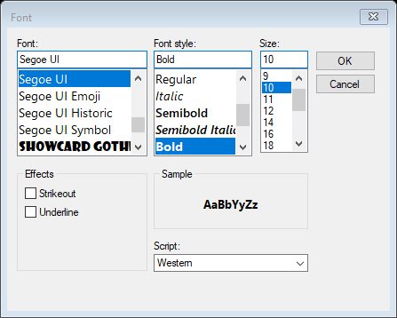
Change Font
Select the font selector in the properties
Change to:
Bold
Size 10

Slide 15

Change Padding
Change Menu Strip Padding
Use drop down and select ScrollBar

Slide 16

Add Panel
Add Panel from Toolbox
Drag and drop a panel in the lower left of the window

Slide 17
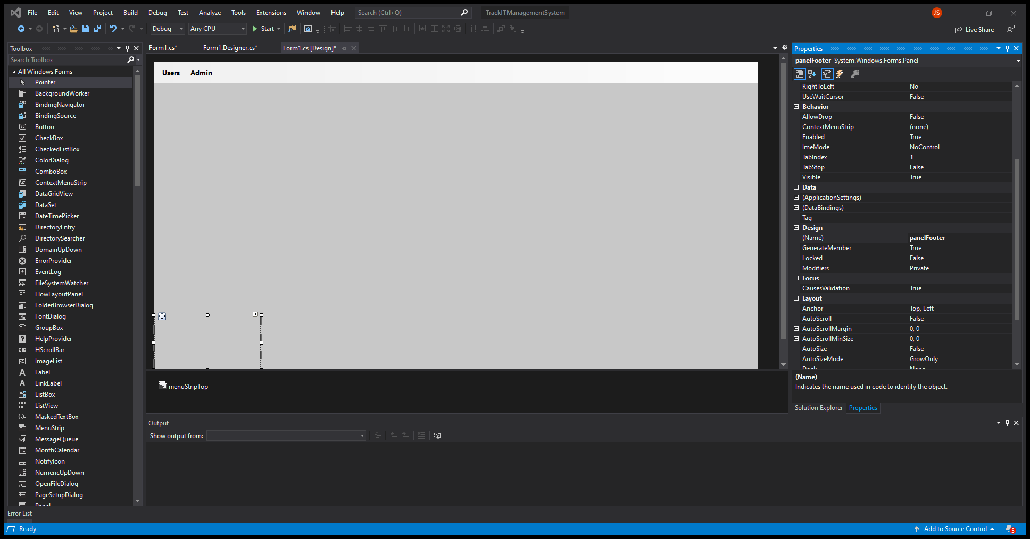
Rename Panel
Rename
In the properties name the panel:
panelFooter

Slide 18
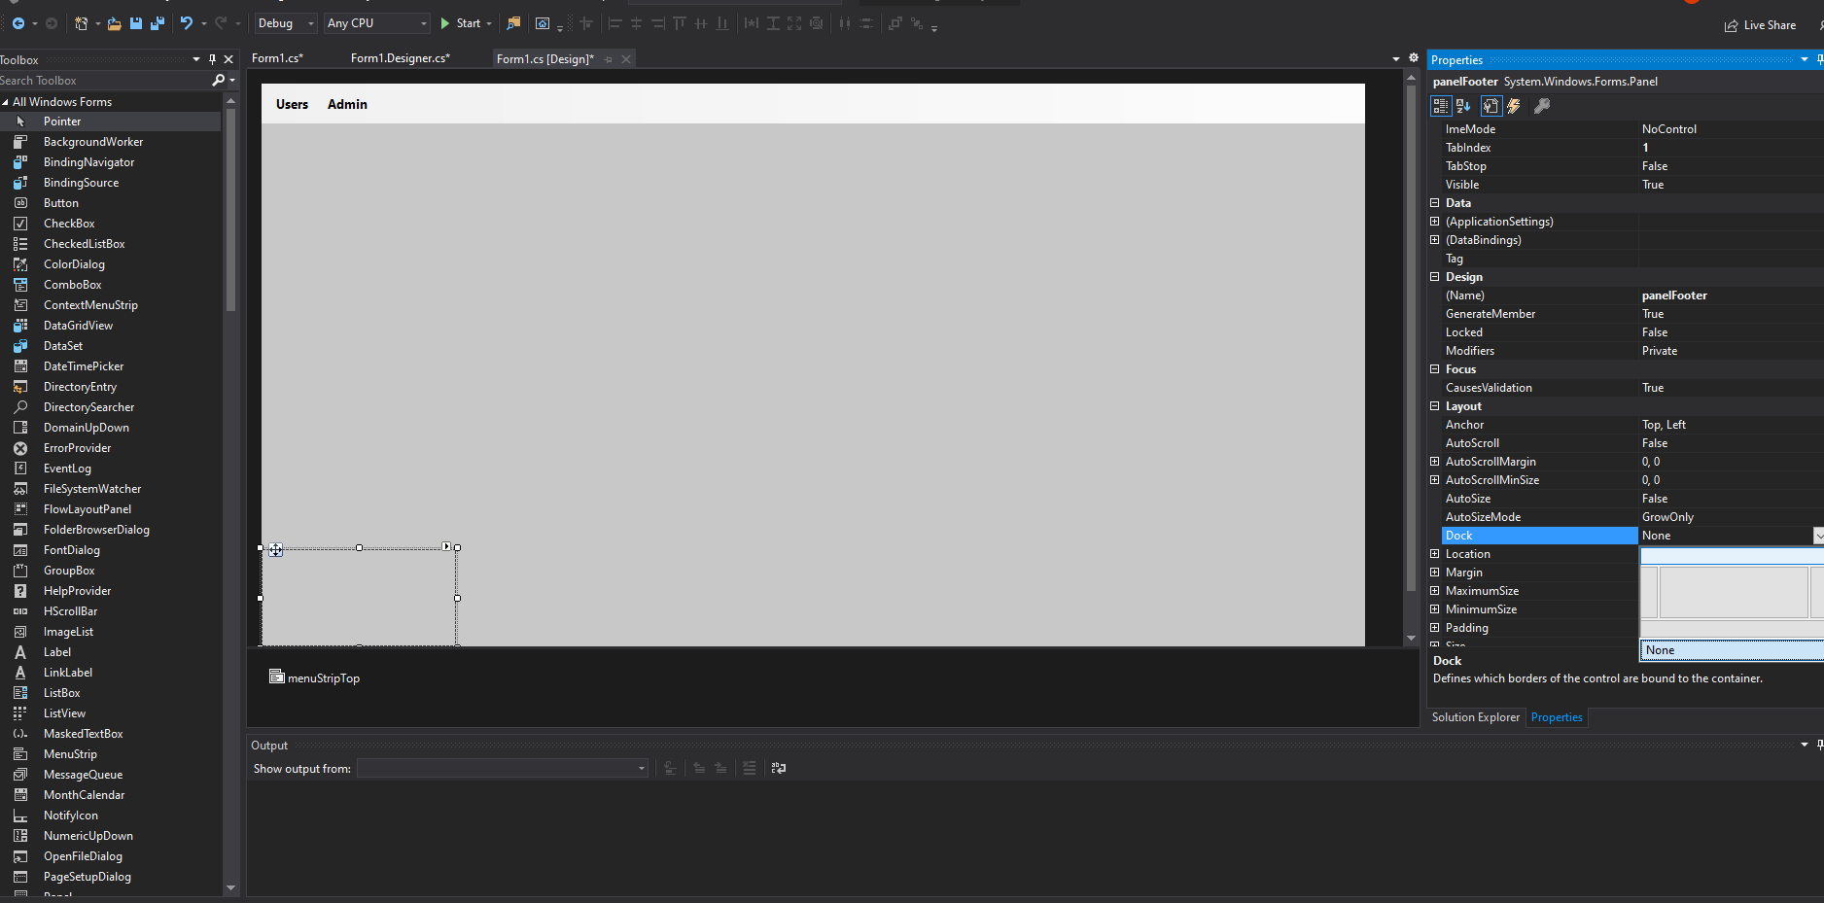
Add Button
Add a button
Under Properties
Select

Slide 19
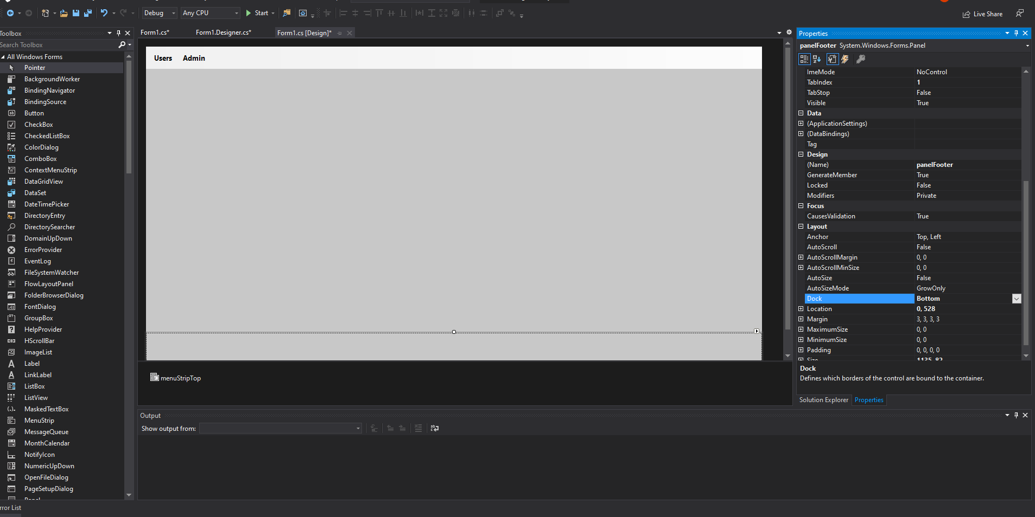
Resize Panel
Resize the panel
Use the panel selection to resize and make the same size (close enough) to match the size of the top menu strip

Slide 20
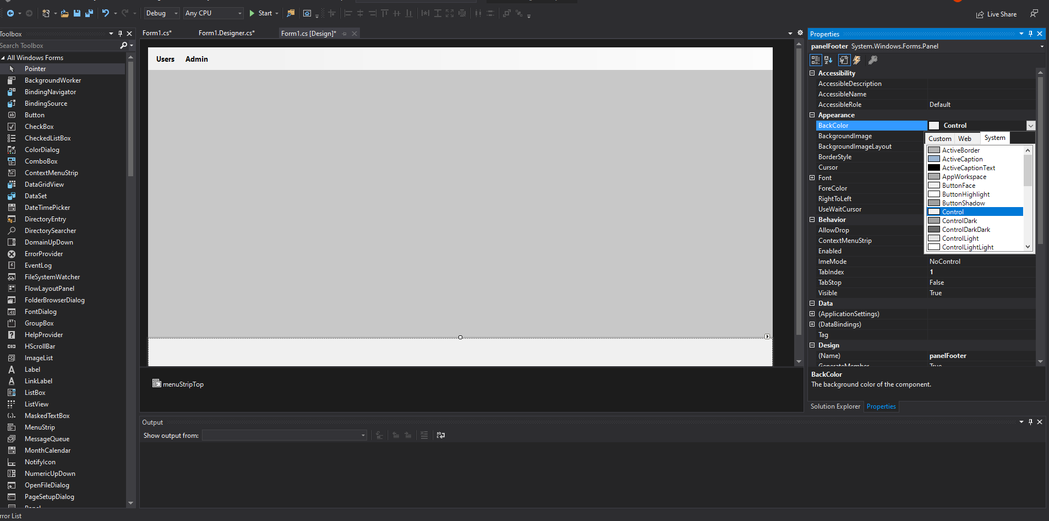
Change Back Color
Change Panel BackColor
Use drop down and select Control

Slide 21
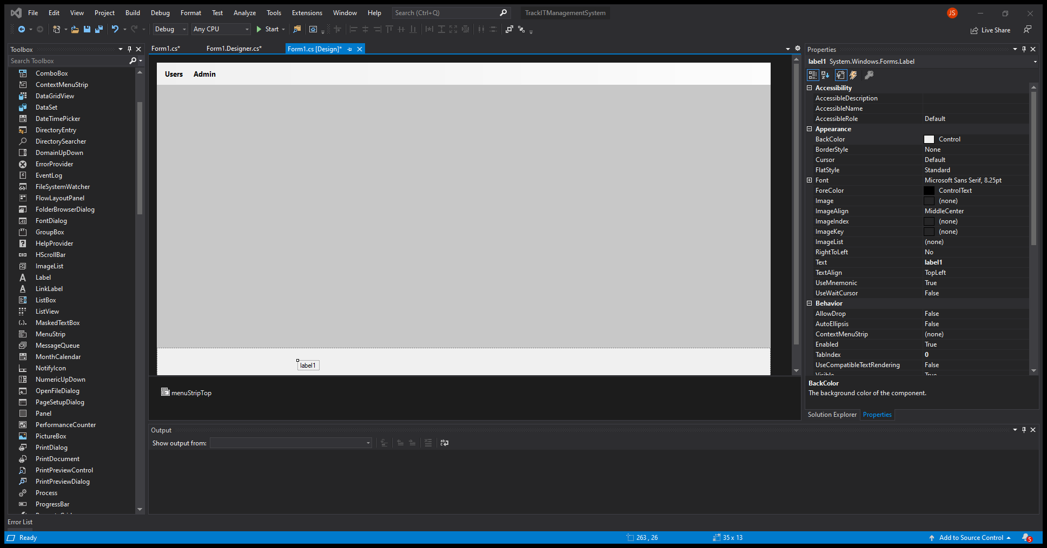
Add a label
Select label from toolbox
Drag and drop it on the panel

Slide 22
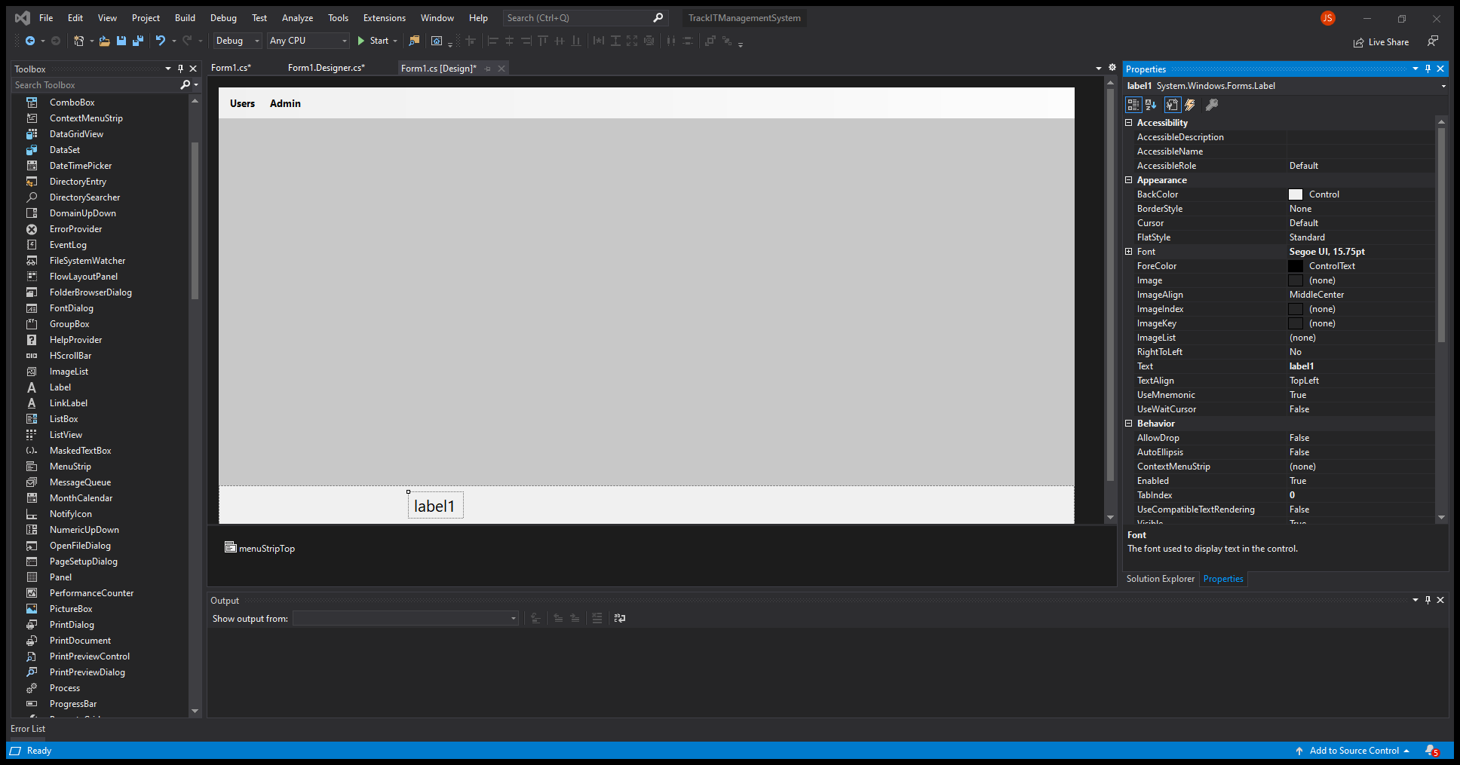
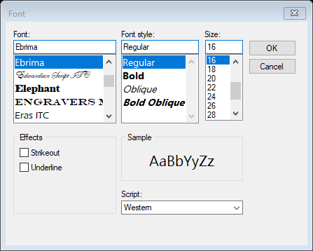
Change Font
Select the font for the label
Change the font to Ebrima
Size to 16

Slide 23
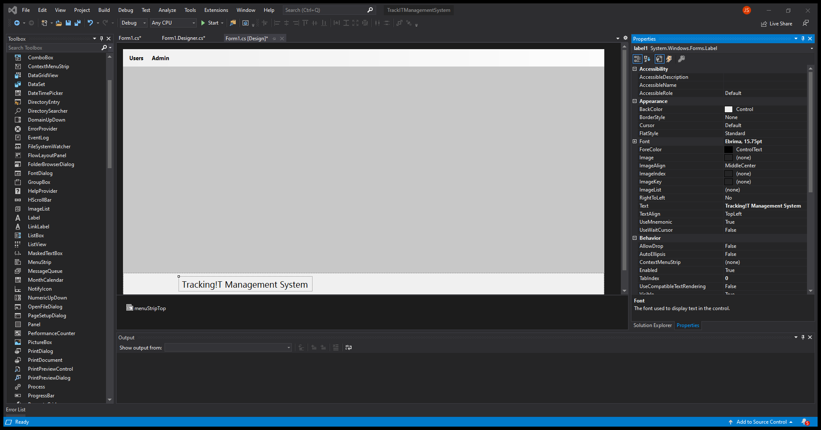
Rename Text
Rename label text
Name it:
Tracking!T Management System

Slide 24
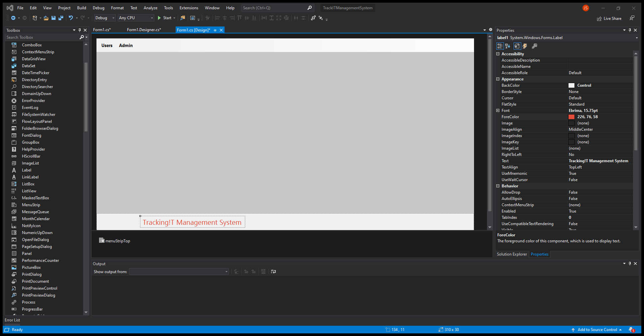
Change Text Color
Select Font ForeColor
Write inside the name box:
226, 76, 58

Slide 25
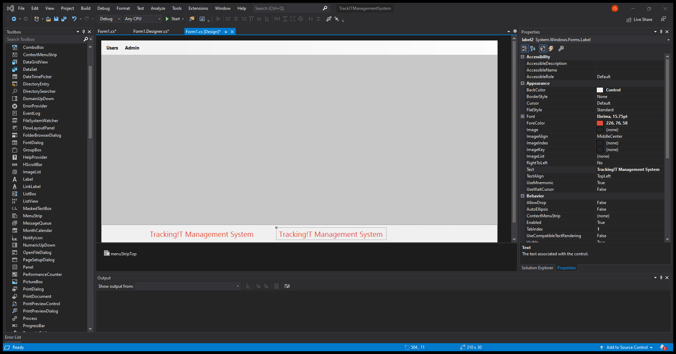
Add Label
Copy and Paste the label
Select the label and copy it
Ctrl-c
Crtl-v

Slide 26
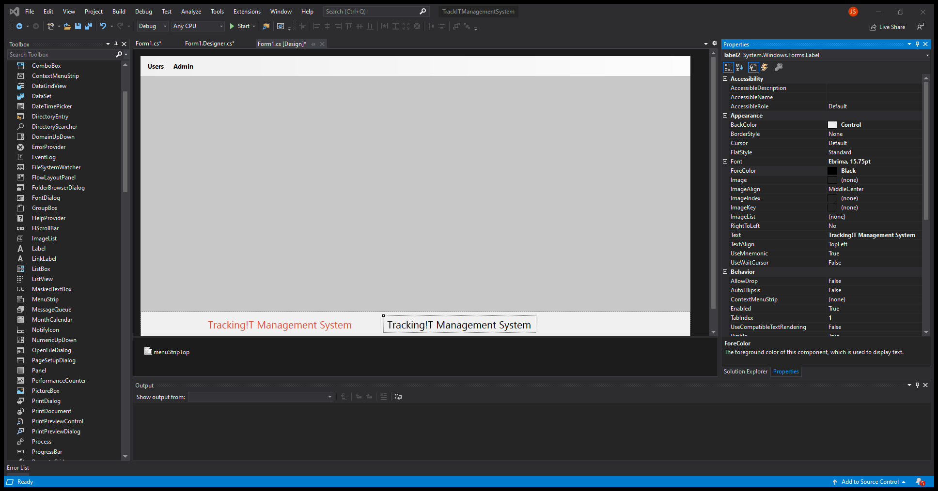
Change Text Color
Select Font ForeColor
Select the web color:
Black

Slide 27

Change Label Text
Change Label Design Name
Rename it to:
lblDevTitle

Slide 28
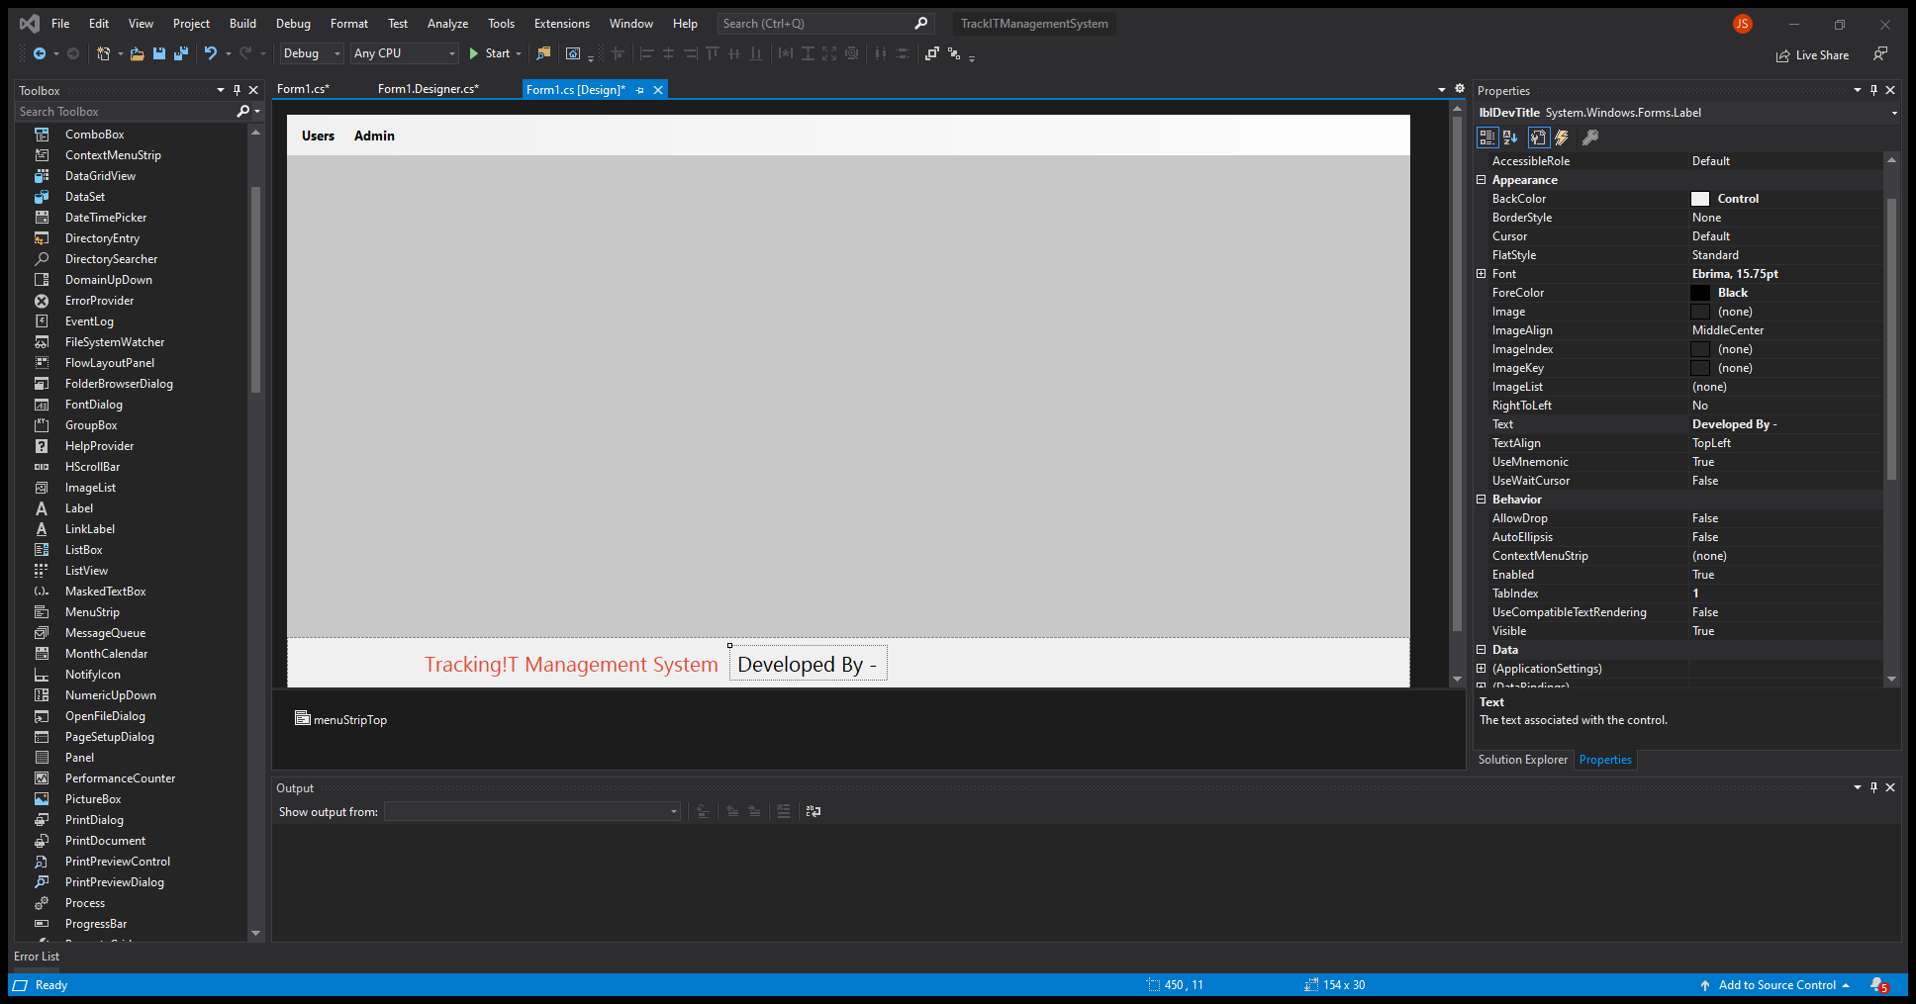
Change Label Text
Change Label Text Name
Rename it to:
Developed By -

Slide 29
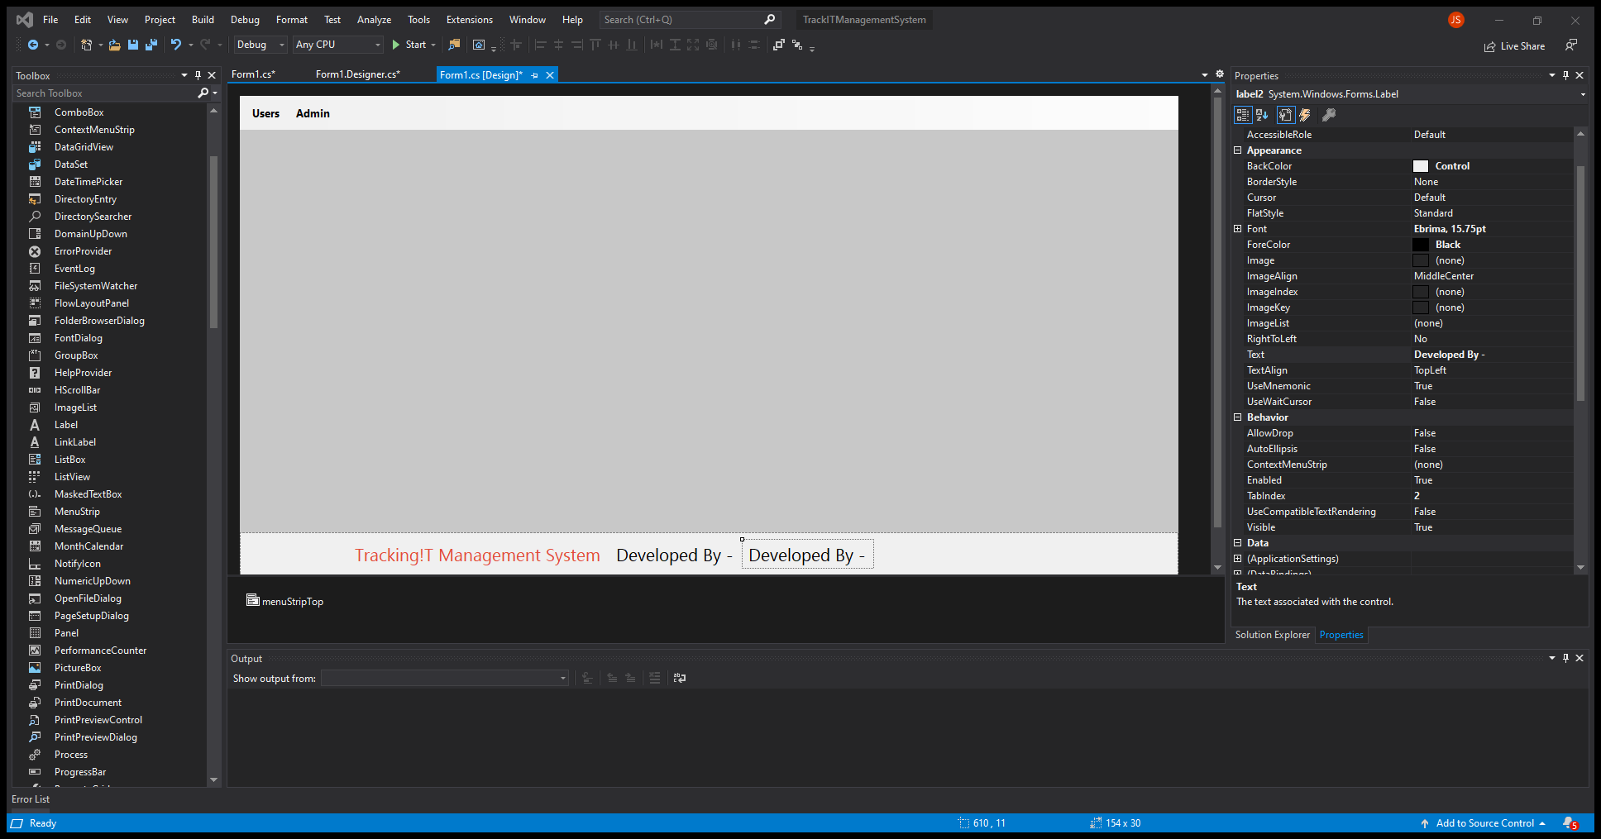
Add Label
Copy and Paste the label
Select the label and copy it
Ctrl-c
Crtl-v

Slide 30

Rename Label
Rename Design Text
lblDeveloper

Slide 31
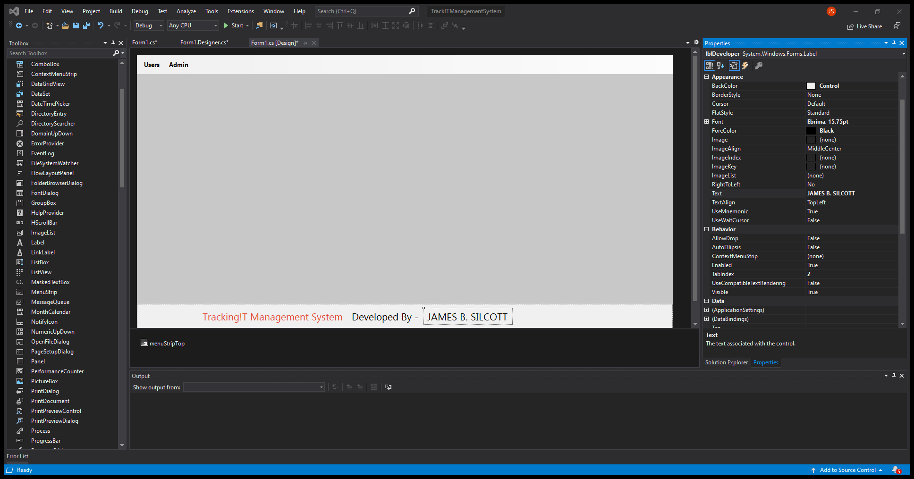
Rename Label
Rename Font Text
Insert Name:
James B. Silcott

Slide 32

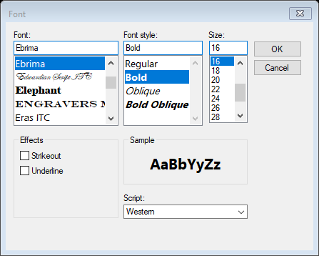
Change Font
Change Font
Select Bold

Slide 33
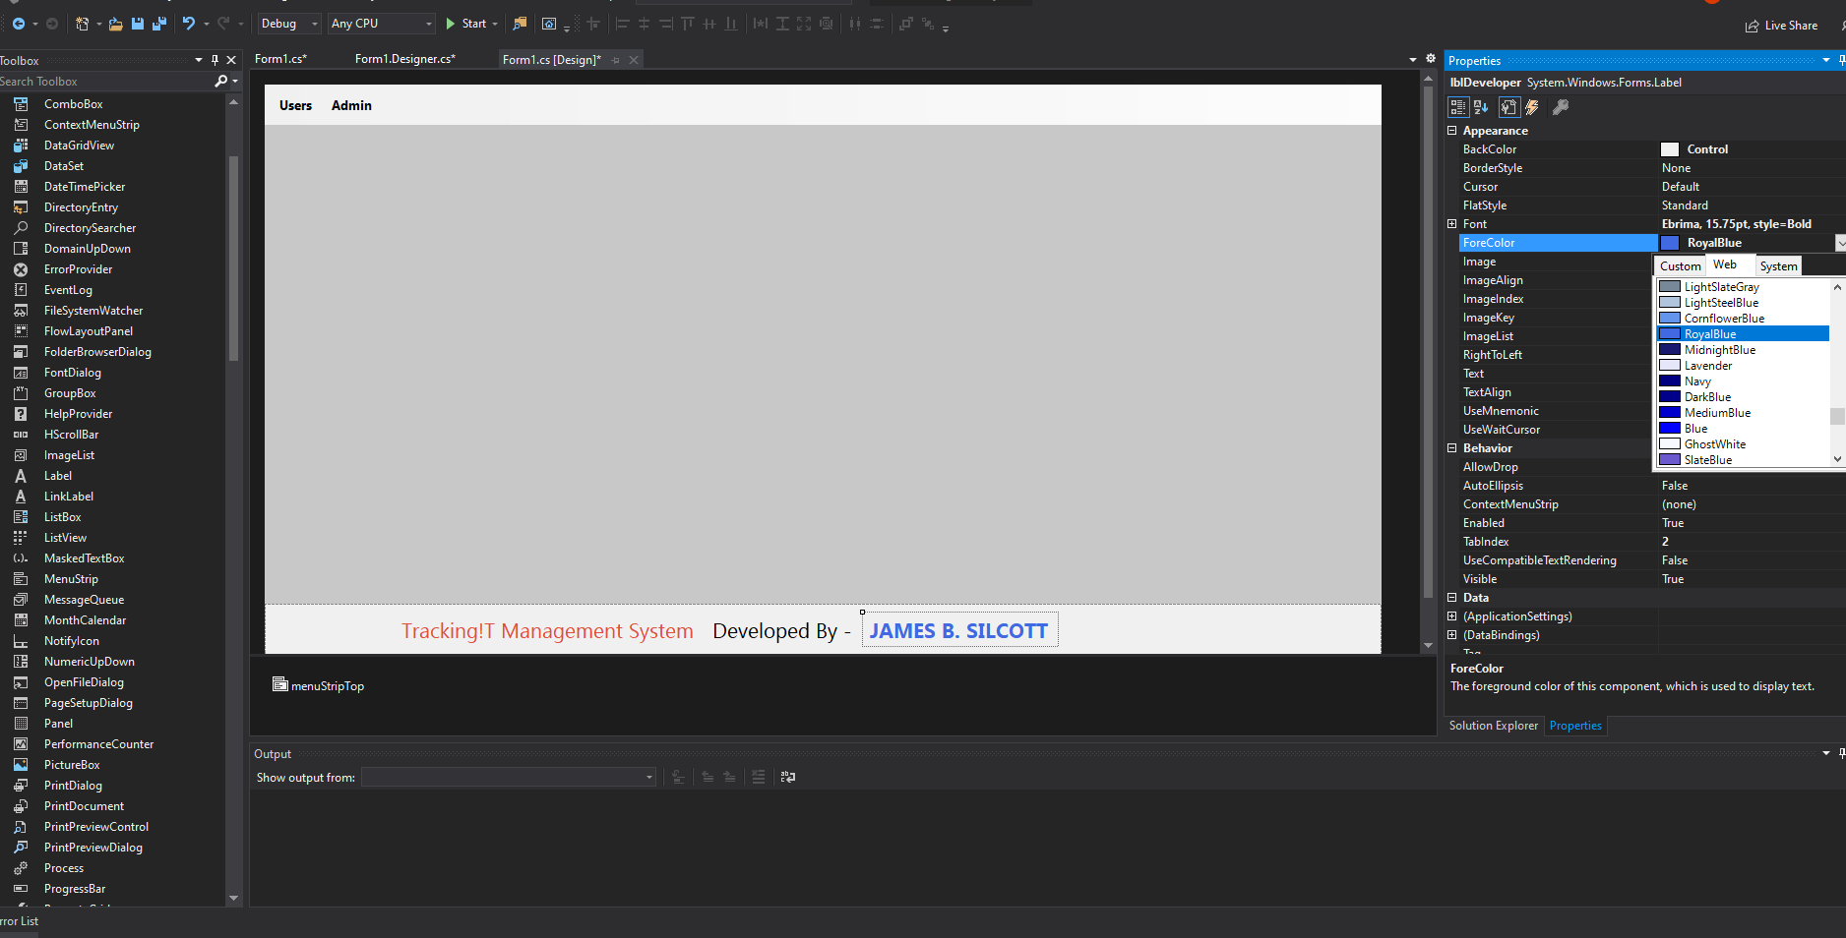
Change Font Color
Change Font Color
Select Royal Blue

Slide 34
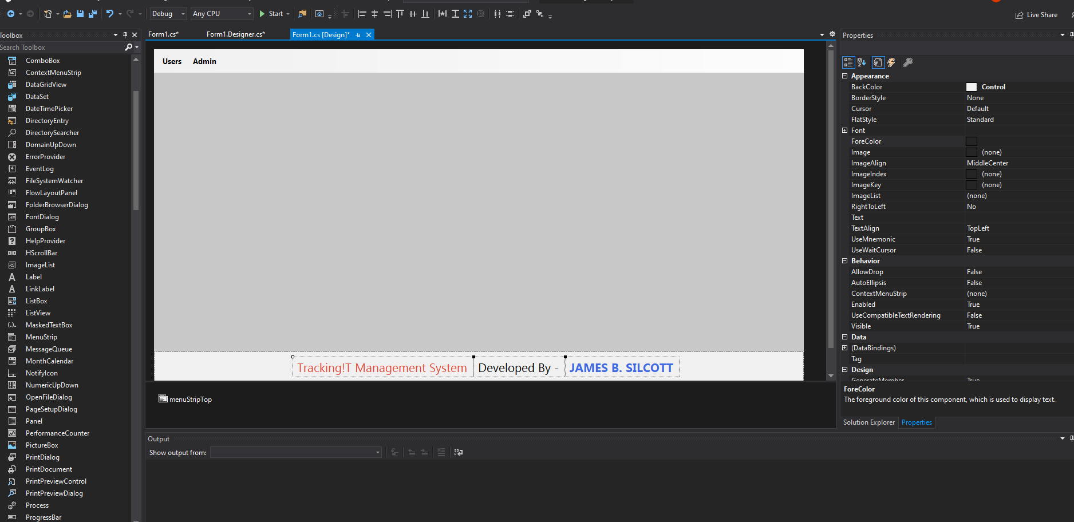
Re-position
Select all the labels
Move and align in the missile of the panel

Slide 35
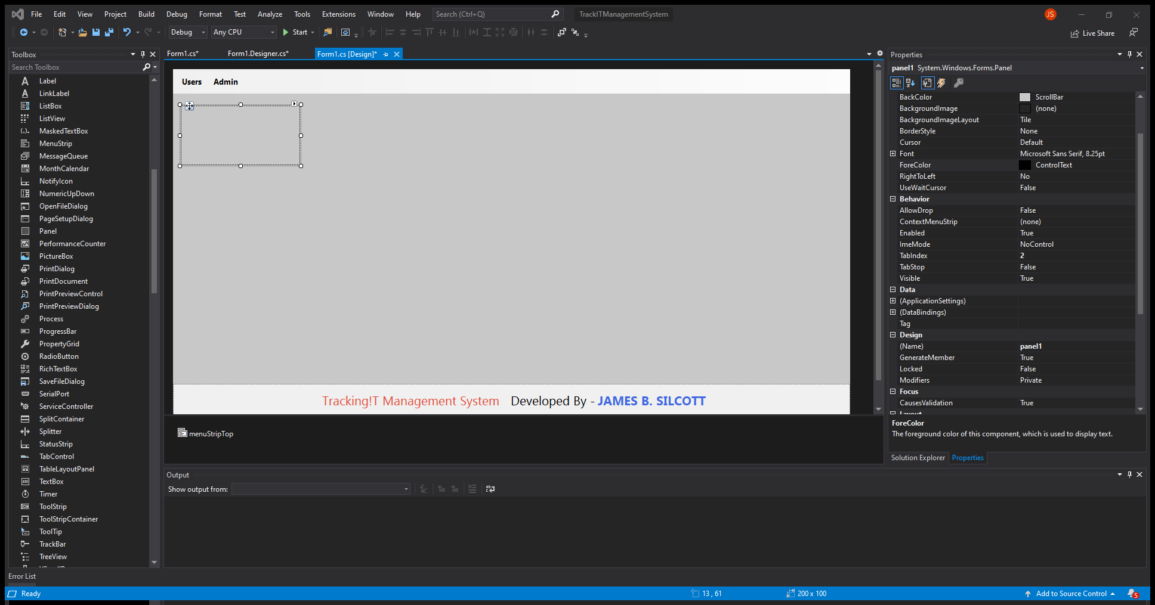
Add Panel
Select a panel from the toolbox
Drag and drop it on the left side of the window

Slide 36

Re-size the panel
Change the size if needed
200, 100

Slide 37
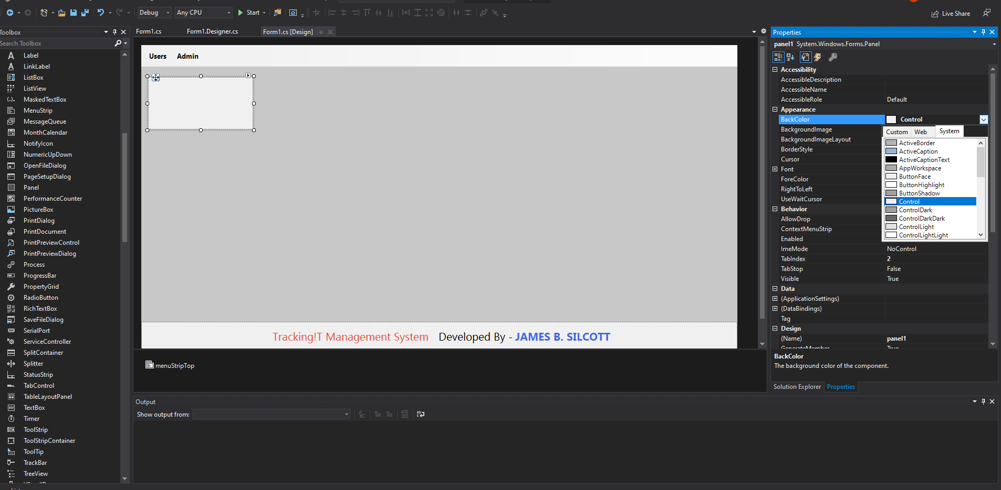
Change Panel Color
Change Panel BackColor
Change to Control color

Slide 38
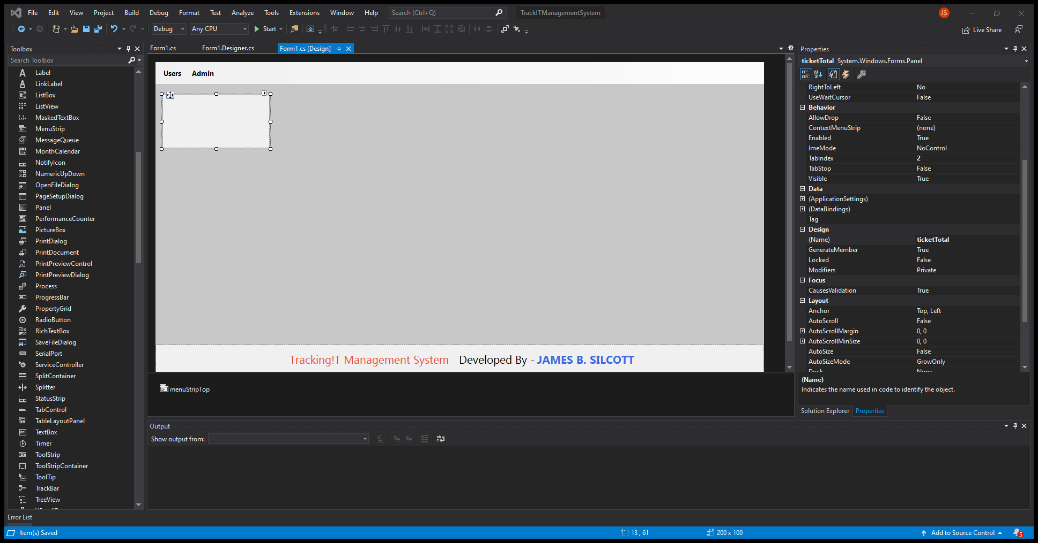
Rename the panel
Rename the design name
Call it:
ticketTotal

Slide 39
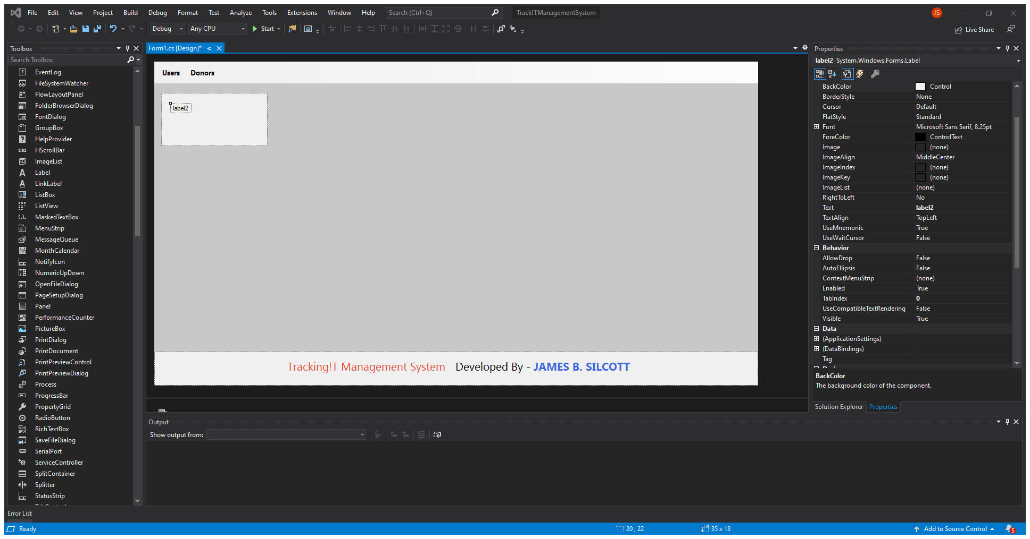
Add Label
Add a label
Drag and drop a label inside the panel

Slide 40
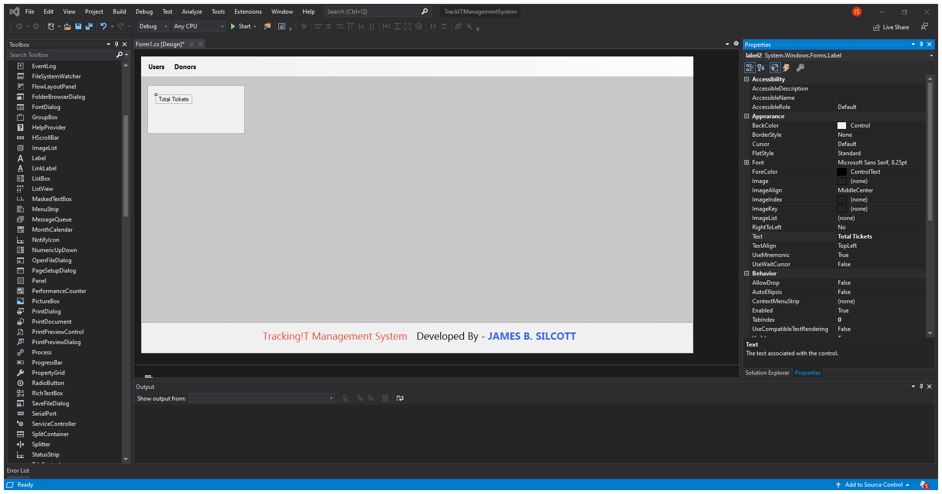
Rename Label
Change text label name
Call it:
Total Tickets

Slide 41

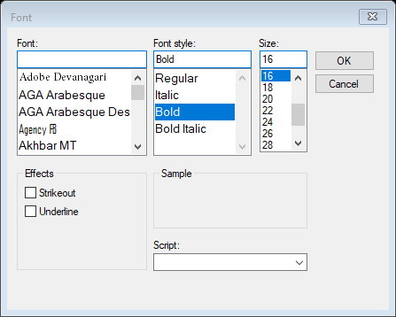
Change Font
Change Font
Change Font to:
Bahnschrift
SemiBold
16

Slide 42
16:14
Add a label
Drag and drop a label inside the panel

Slide 43
Add Label
Add a label
Drag and drop a label inside the panel

Slide 44
Add Label
Add a label
Drag and drop a label inside the panel

Slide 45
Add Label
Add a label
Drag and drop a label inside the panel

Slide 46
Add Label
Add a label
Drag and drop a label inside the panel

Slide 47
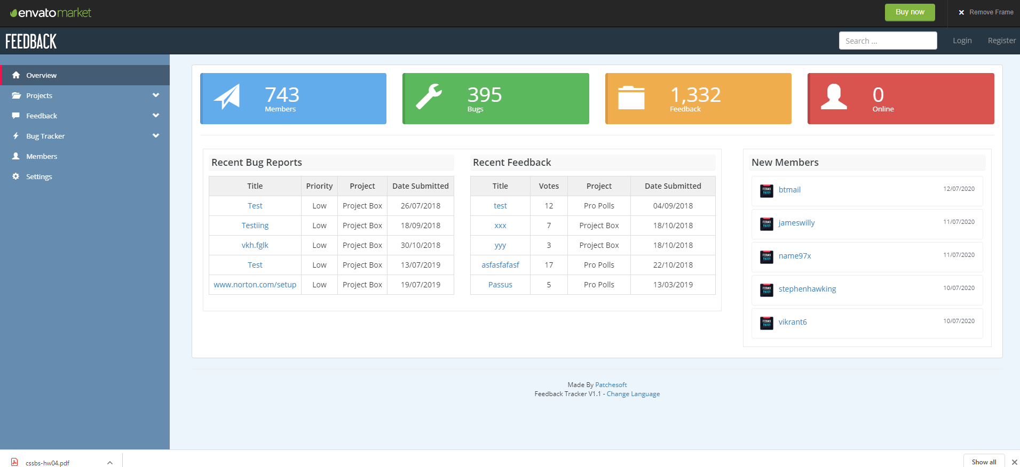
Change Back Color
preview.codecanyon.net/item/feedback-bug-tracker-management-tool/full_screen_preview/11449687?_ga=2.151661177.1905950628.1594668803-1210016305.1594668803
Change Window BackColor
Use drop down and select ScrollBar

Slide 48
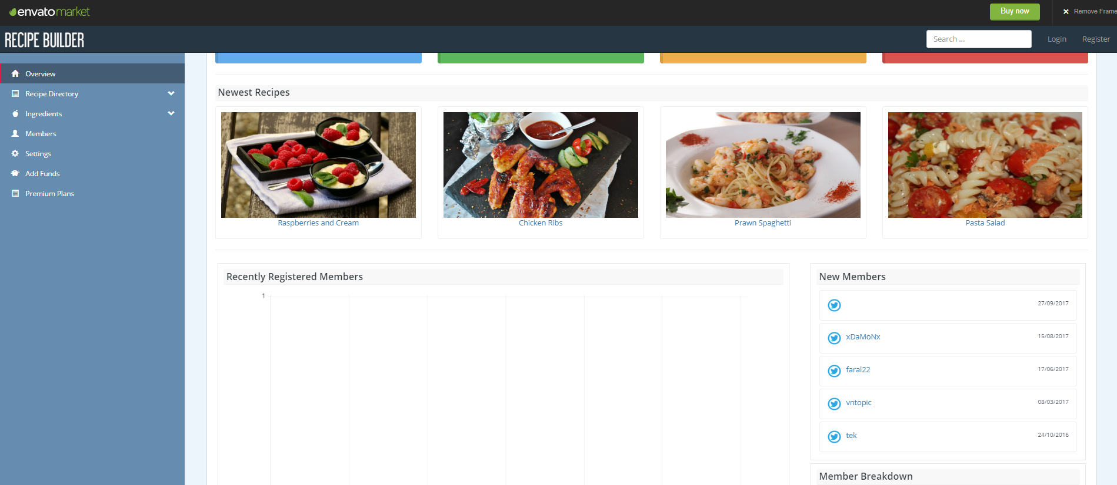
Change Back Color
preview.codecanyon.net/item/feedback-bug-tracker-management-tool/full_screen_preview/11449687?_ga=2.151661177.1905950628.1594668803-1210016305.1594668803
Change Window BackColor
Use drop down and select ScrollBar
preview.codecanyon.net/item/recipe-builder-user-management-system/full_screen_preview/17527249?_ga=2.230619996.1592419295.1594669034-1210016305.1594668803

Slide 49
codecanyon.net/item/recipe-builder-user-management-system/17527249
codecanyon.net/item/project-box-team-management-tool/8103343?s_rank=13

Slide 50
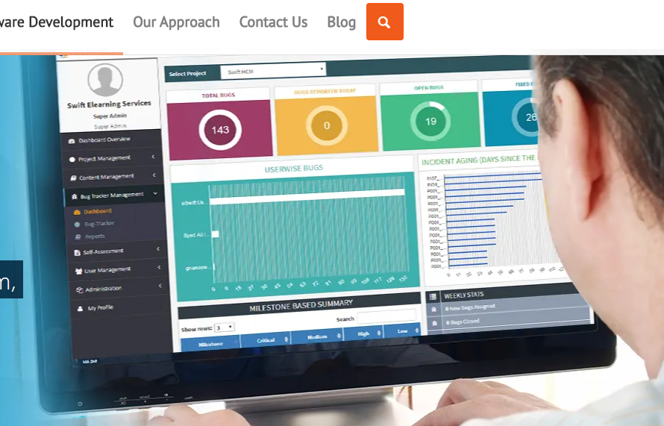
Change Back Color
Change Window BackColor
Use drop down and select ScrollBar

Slide 51
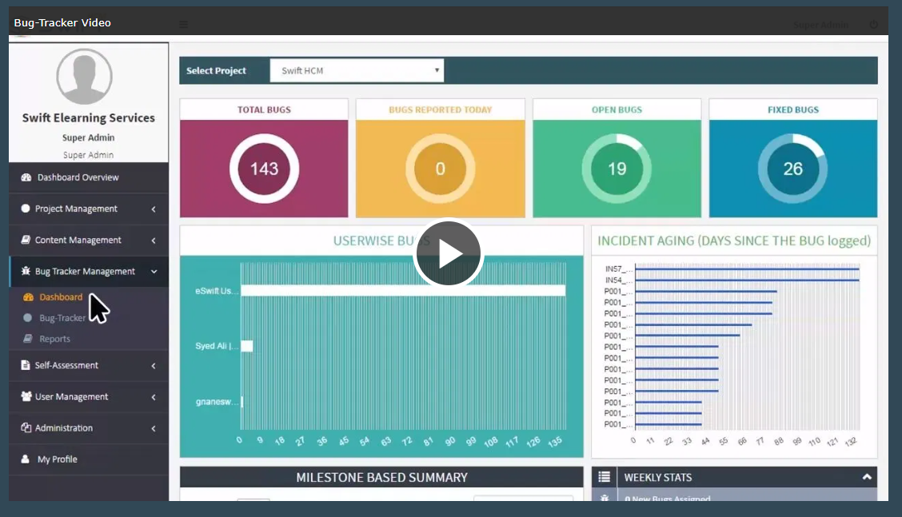
Change Back Color
Change Window BackColor
Use drop down and select ScrollBar
ticketTotal
ticketTotalReportedToday
ticketOpen
ticketCompleted

Slide 52
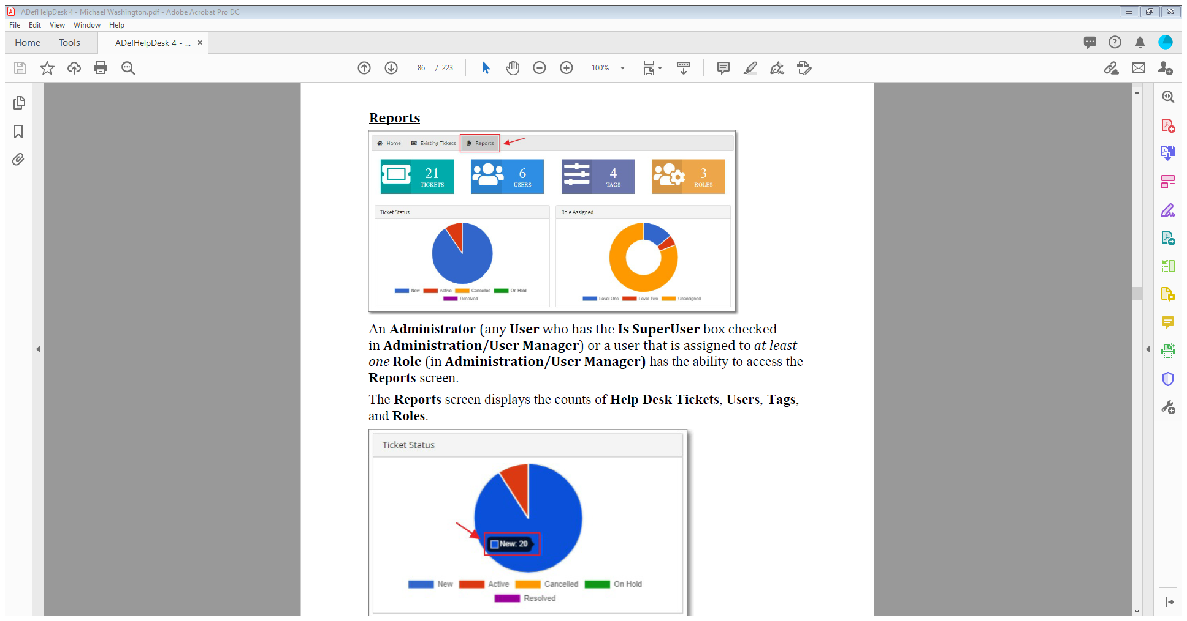
Change Back Color
Change Window BackColor
Use drop down and select ScrollBar

Slide 53
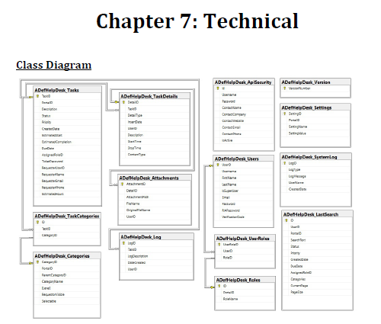
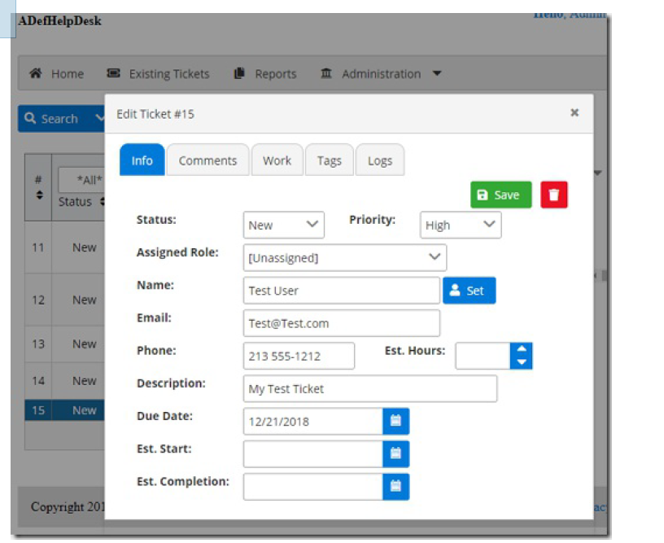

Slide 54
